Slide 1
Welcome to Week 15, Lecture 01!
Intro to Hypothesis Testing

Slide 2
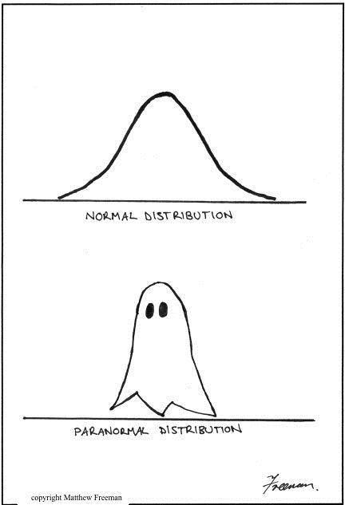
Agenda
Intro to Hypothesis Testing
Mock Exam

Slide 3
Assignments
This week’s assignments:
Project 3 Part 3(Core)
Describing Distributions (Core)
Hypothesis Testing with Insurance Data(Core)
Remember that Belt Exam eligibility is this Friday at 9AM
Make sure you have all of week 1 and 2 assignments submitted and any resubmits from week 1.
Note that content from this week (week 3 of the stack) is assessed on the exam!

Slide 4
Hypothesis Testing

Slide 5


Slide 6
Hypothesis Testing: Getting Started
Is there actually a significant difference between two groups or are the differences just due to randomness?
Example:
A survey goes out and asks students to rate Jupyter notebooks and Google Colab each on a scale of 1-5.
On average, Jupyter scores higher, but can we conclude that students really do prefer Jupyter notebooks or is it just due to randomness?

Slide 7
State the null and alternate hypothesis
Null Hypothesis:
The null hypothesis is the one that seems like it doesn’t need to be stated! It is that there is nothing special going on. In our case:
Null Hypothesis (H₀): There is NO difference between ratings for Jupyter notebooks and Google Colab
Alternate Hypothesis:
The alternate hypothesis is usually what you would just think of as “the” hypothesis! It states that something significant is going on.
Alternate Hypothesis: (H_{a}) There is a significant difference between ratings for Jupyter notebooks and Google Colab

Slide 8
Establish the significance Level (alpha)
The most common significance value is alpha = 0.05.
This means that if the likelihood of the results due to random chance (p) is less than 5%, we consider the results significant (and not just random).
If we use a significance value of 0.01, it means than the likelihood of the results due to randomness (p) must be less than 1% in order for us to claim it is significant.
Setting an alpha value establishes your willingness to accept Type 1 or Type 2 errors, and really it depends on your data and situation. When in doubt, consult a SME!
Examples of Type 1 and 2 Errors with Hypothesis Testing

Slide 9
Perform the test to get a p value
There are many different statistical tests, but the interpretation is generally the same!
Whichever statistical test you use, you will be given a p-value in your results.
The p-value is the probability of your situation (like the difference in ratings for Jupyter and Colab) occurring at random.
If your p is < alpha, you have a significant result and reject the null hypothesis.
You conclude there is a significant difference in the ratings.
If you p is > alpha, you do not have a significant results and “fail to reject” the null hypothesis.
You conclude there is NOT a significant difference in the ratings.

